Slide 1


Chapter 2
Communication

Slide 2
Extended Remote Procedure Call
Is a communication model where the client sends a request to a server and doesn't wait for an immediate response.
Instead of blocking and waiting for the server to process the request and return a result, the client is free to perform other tasks or handle other requests.
The server processes the request independently, and when the operation is complete, it notifies the client, often via a callback or some other mechanism.

Slide 3
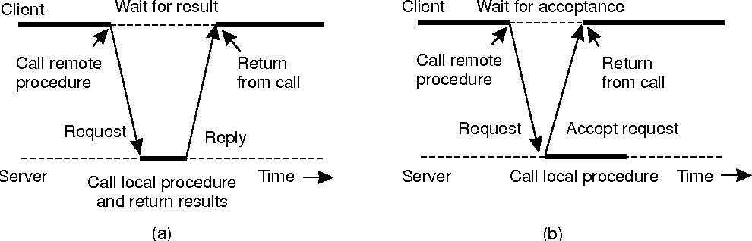
Extended Remote Procedure Call
The interaction between client and server in a traditional RPC.
The interaction using asynchronous RPC.

Slide 4
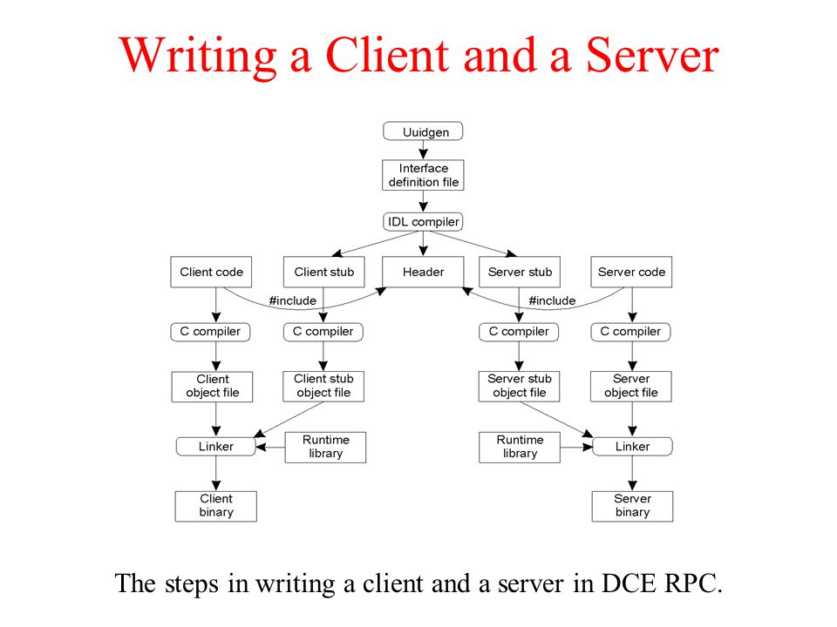
DCE RPC (writing Client-Server)
Steps in writing a client and a server in DCE RPC.

Slide 5
DCE Remote Procedure Call
Define the Interface:
Begin by defining the interface in the Interface Definition Language (IDL).
This is where you specify the procedures that the client and server will use. Save it with a “.idl” extension.
Compile the IDL:
Use the DCE IDL compiler to generate client and server stubs from your IDL file.

Slide 6
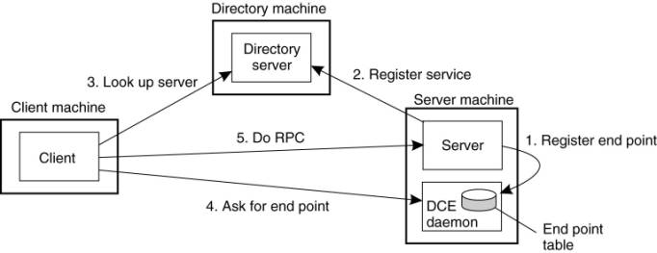
DCE RPC (Client-Server Binding)
Client-to-server binding in DCE

Slide 7
Remote object Invocation
Remote Object Invocation (ROI) refers to the process of invoking methods or functions on objects that reside in a different address space or on a remote machine.
In simpler terms, it's a mechanism that allows you to call methods on objects that are not co-located with the calling code.
Example: Remote Method Invocation (RMI)
Mobile banking application on your smartphone.
When you log in and check your account balance, the app needs to retrieve your account information from a remote server.
In this scenario, the remote object invocation mechanism allows the client (your mobile banking app) to interact with objects (account data) residing on a remote server.

Slide 8
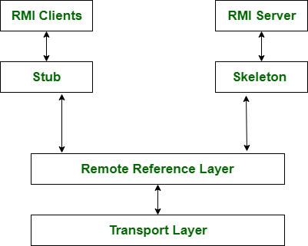
Remote Method Invocation
Remote Method Invocation (RMI) is a mechanism in Java that allows a Java program to invoke methods on objects that reside in a different Java Virtual Machine (JVM), typically on a remote server.
Remote Method Invocation Architecture

Slide 9
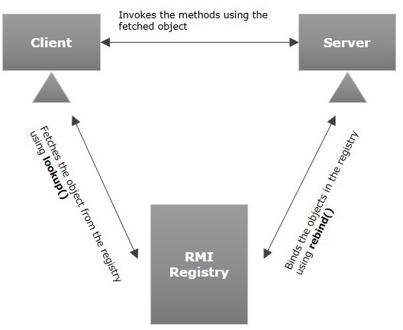
Remote Method Invocation
Binding an RMI client to an RMI server involves establishing a connection between the client and the server and then looking up the remote object on the server side.
Binding a client to a server

Slide 10
Remote object Invocation
RMI Registry:
The RMI registry is a simple naming service that allows clients to look up remote objects by their names.
Remote Interfaces:
You start by defining the interfaces for the remote objects that you want to access remotely.
These interfaces should extend the “java.rmi.Remote” interface and declare the methods that can be invoked remotely.

Slide 11
Remote object Invocation
Remote Reference Layer:
Plays a crucial role in managing the communication between objects that reside in different address spaces or on different machines.
It's responsible for handling the references to remote objects and enabling the invocation of methods on those objects as if they were local.

Slide 12
Role of the Remote Reference Layer
Object Identification:
The Remote Reference Layer provides mechanisms for uniquely identifying remote objects within a distributed system.
This typically involves assigning globally unique identifiers (such as object references or URLs) to remote objects to facilitate their identification and access.
Marshalling and Unmarshalling:
Remote method invocation involves passing data and parameters between different address spaces or machines.
The Remote Reference Layer is responsible for marshalling (serializing) method calls and their arguments into a format suitable for transmission over the network and unmarshalling (deserializing) the received data back into the appropriate form for execution.

Slide 13
Role of the Remote Reference Layer
Remote Object Lookup:
In order to invoke methods on remote objects, clients need to obtain references to those objects.
The Remote Reference Layer provides mechanisms for clients to look up and obtain references to remote objects, typically using registries or naming services.
Stubs and Skeletons:
In some distributed systems, the Remote Reference Layer uses stubs and skeletons to facilitate communication between clients and remote objects.
Stubs on the client-side act as proxies for the remote objects, intercepting method invocations and forwarding them over the network.
Skeletons on the server side receive incoming method invocations, unmarshal them, and dispatch them to the appropriate remote objects.

Slide 14
Static and Dynamic RMI
Static Remote Method Invocation:
Predefined and fixed interfaces or methods known at compile time, similar to having a fixed list of contacts or menu items.
Example: Phone Contacts List
Think of your phone's contact list as a static RMI scenario. You have a predefined list of contacts with their phone numbers saved in your phone.
You can call or message them directly because you know their contact details beforehand.
This is similar to how static RMI works, where the remote interface (contact details) is predefined at compile time.

Slide 15
Static and Dynamic RMI
Dynamic RMI:
Interfaces or methods that can change or be discovered dynamically at runtime, similar to dynamically adding or removing contacts from your phone or discovering new products in an online marketplace.
Example: Online Marketplace
Imagine an online marketplace where different sellers offer various products for sale.
As a buyer, you can search for products dynamically based on your preferences.
Sellers can dynamically list new products, and buyers can dynamically discover and purchase them.
This is similar to dynamic RMI, where services (products) are dynamically added and discovered at runtime.

